Slide 1
MINI PROJECT 2 DATA MINING & WAREHOUSING Gunathilaka D. D. T. M. IT13011130 WD-SE 4th year 2nd semester 2016

Slide 2
Case Study
The Following report describes the implementation procedure of data warehouse for “Online News Popularity” dataset. The data set summarizes a heterogeneous set of features about articles published by Mashable in a period of two years. (www.mashable.com). Data set contains information relevant to each department of the company. Therefore, a data warehouse has been implemented to integrate all those information of articles for analysis and reporting purposes.
Dataset URL: https://archive.ics.uci.edu/ml/datasets/Online+News+Popularity

Slide 3
Tools
MS Visual Studio 2015
Business Intelligence Template
MS SQL Server Management Studio 2016
SSIS, SSAS, SSRS
MS Power BI
Visualization

Slide 4
Dimension tables
The dimension tables contain different perspectives that we can take measurements from respective facts table. Dimensions are taken considering articles ratios, keywords, data channel, dates, closeness, polarity, counts and shares.

Slide 5
Create Dimensions
Drop Table Dim_Rate
Go
Create Table Dim_Rate
(
Rate_ID bigint identity(1,1) not null primary key nonclustered,
global_rate_positive_words real,
global_rate_negative_words real,
rate_positive_words real,
rate_negative_words real,
n_unique_tokens real,
n_non_stop_words real,
n_non_stop_unique_tokens real
)
Go
Select * From Dim_Rate

Slide 6
Create Dimensions
Drop Table Dim_Keyword
Go
Create Table Dim_Keyword
(
Keyword_ID bigint identity(1,1) not null primary key nonclustered,
kw_min_min bigint,
kw_max_min bigint,
kw_avg_min real,
kw_min_max bigint,
kw_max_max bigint,
kw_avg_max real,
kw_min_avg real,
kw_max_avg real,
kw_avg_avg real
)
Go
Select * From Dim_Keyword

Slide 7
Create Dimensions
Drop Table Dim_DataChannel
Go
Create Table Dim_DataChannel
(
DataChannel_ID bigint identity(1,1) not null primary key nonclustered,
data_channel_is_lifestyle bigint,
data_channel_is_entertainment bigint,
data_channel_is_bus bigint,
data_channel_is_socmed bigint,
data_channel_is_tech bigint,
data_channel_is_world bigint
)
Go
Select * From Dim_DataChannel

Slide 8
Create Dimensions
Drop Table Dim_PublishedOn
Go
Create Table Dim_PublishedOn
(
PublishedOn_ID bigint identity(1,1) not null primary key nonclustered,
weekday_is_monday bigint,
weekday_is_tuesday bigint,
weekday_is_wednesday bigint,
weekday_is_thursday bigint,
weekday_is_friday bigint,
weekday_is_saturday bigint,
weekday_is_sunday bigint,
is_weekend bigint
)
Go
Select * From Dim_PublishedOn

Slide 9
Create Dimensions
Drop Table Dim_Closeness
Go
Create Table Dim_Closeness
(
Closeness_ID bigint identity(1,1) not null primary key nonclustered,
LDA_00 real,
LDA_01 real,
LDA_02 real,
LDA_03 real,
LDA_04 real
)
Go
Select * From Dim_Closeness

Slide 10
Create Dimensions
Drop Table Dim_Polarity
Go
Create Table Dim_Polarity
(
Polarity_ID bigint identity(1,1) not null primary key nonclustered,
avg_positive_polarity real,
min_positive_polarity real,
max_positive_polarity real,
avg_negative_polarity real,
min_negative_polarity real,
max_negative_polarity real,
abs_title_sentiment_polarity real,
global_sentiment_polarity real,
title_sentiment_polarity real
)
Go
Select * From Dim_Polarity

Slide 11
Create Dimensions
Drop Table Dim_Count
Go
Create Table Dim_Count
(
Count_ID bigint identity(1,1) not null primary key nonclustered,
n_tokens_title bigint,
n_tokens_content bigint,
num_hrefs bigint,
num_self_hrefs bigint,
num_imgs bigint,
num_videos bigint,
average_token_length real,
num_keywords bigint
)
Go
Select * From Dim_Count

Slide 12
Create Dimensions
Drop Table Dim_Share
Go
Create Table Dim_Share
(
Share_ID bigint identity(1,1) not null primary key nonclustered,
self_reference_min_shares bigint,
self_reference_max_shares bigint,
self_reference_avg_sharess real,
timedelta bigint,
)
Go
Select * From Dim_Share

Slide 13
Facts table
The facts table contains measures that we take to evaluate the performance. In this case study the predicted number of shares measured for given various articles.

Slide 14
Create Facts Table
Drop Table Fact_NewsPopularity
Go
Create Table Fact_NewsPopularity
(
url nvarchar(4000),
shares bigint,
Rate_ID bigint not null references Dim_Rate(Rate_ID),
Keyword_ID bigint not null references Dim_Keyword(Keyword_ID),
DataChannel_ID bigint not null references Dim_DataChannel(DataChannel_ID),
PublishedOn_ID bigint not null references Dim_PublishedOn(PublishedOn_ID),
Closeness_ID bigint not null references Dim_Closeness(Closeness_ID),
Polarity_ID bigint not null references Dim_Polarity(Polarity_ID),
Subjectivity_ID bigint not null references Dim_Subjectivity(Subjectivity_ID),
Count_ID bigint not null references Dim_Count(Count_ID),
Share_ID bigint not null references Dim_Share(Share_ID),
constraint NewsPopularity_pk primary key nonclustered ( Rate_ID , Keyword_ID , DataChannel_ID , PublishedOn_ID , Closeness_ID , Polarity_ID , Subjectivity_ID , Count_ID , Share_ID )
)
Go
Select * From Fact_NewsPopularity

Slide 15
Design of Data Warehouse
OnlineNewsPopulation.csv
Extraction Transformation Loading (ETL)
Data Warehouse
Facts
Sharing Information
Dimensions
Statistical Data From :
ratios
keywords
data channel
Dates
Closeness
polarity
Counts
shares
SQL Server Analyzing Services (SSAS)
SQL Server Reporting Services (SSRS)

Slide 16
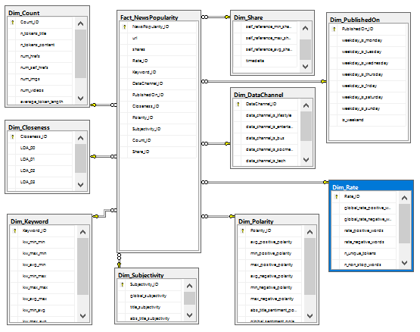
Schema

Slide 17
Data Integration
SQL Server Integration Service (SSIS)
VS 2015

Slide 18
Data Analysis
SQL Server Analysis Service (SSAS)
VS 2015

Slide 19
Visualization
Graphical Analysis
Power BI

Slide 20
Data Reporting
SQL Server Reporting Service (SSRS)
VS 2015

Slide 21
Thank You

